Slide 1
CSE408 Modular Arithmetic & Chinese Remainder Theorem
Lecture # 38

Slide 2
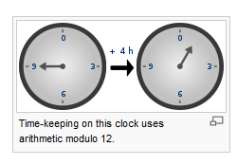
Modular Arthmetic
In mathematics, modular arithmetic (sometimes called clock arithmetic) is a system of arithmetic for integers, where numbers "wrap around" upon reaching a certain value—the modulus.

Slide 3
Modular Arthmetic
Modular arithmetic can be handled mathematically by introducing a congruence relation on the integers that is compatible with the operations of the ring of integers: addition, subtraction, and multiplication. For a positive integer n, two integers a and b are said to be congruent modulo n, written:
if their difference a − b is an integer multiple of n (or n divides a − b). The number n is called the modulus of the congruence.

Slide 4


The properties that make this relation a congruence relation (respecting addition, subtraction, and multiplication) are the following.
If
And
then:
It should be noted that the above two properties would still hold if the theory were expanded to include all real numbers, that is if were not necessarily all integers. The next property, however, would fail if these variables were not all integers:

Slide 5
Chinese Theorem
The Chinese remainder theorem is a result about congruences in number theory and its generalizations in abstract algebra. It was first published in the 3rd to 5th centuries by Chinese mathematician Sun Tzu.
In its basic form, the Chinese remainder theorem will determine a number n that when divided by some given divisors leaves given remainders.
For example, what is the lowest number n that when divided by 3 leaves a remainder of 2, when divided by 5 leaves a remainder of 3, and when divided by 7 leaves a remainder of 2?
A common introductory example is a woman who tells a policeman that she lost her basket of eggs, and that if she makes three portions at a time out of it, she was left with 2, if she makes five portions at a time out of it, she was left with 3, and if she makes seven portions at a time out of it, she was left with 2.
She then asks the policeman what is the minimum number of eggs she must have had. The answer to both problems is 23.

Slide 6
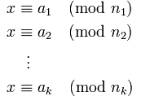
Suppose n₁, n₂, …, n_{k} are positive integers that are pairwise coprime. Then, for any given sequence of integers a₁,a₂, …, a_{k}, there exists an integer x solving the following system of simultaneous congruences.

Slide 7
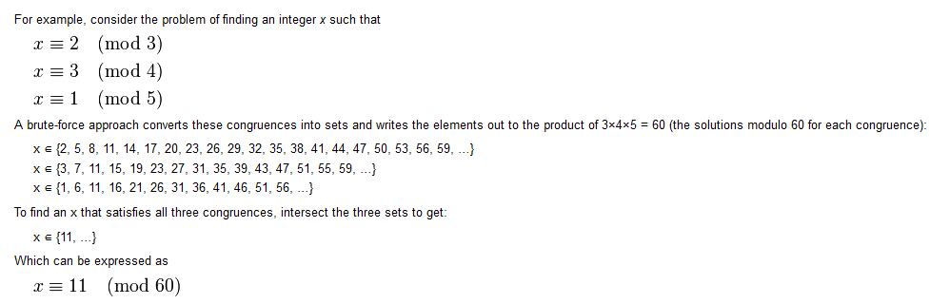
Example
Brute Force Technique:-

Slide 8
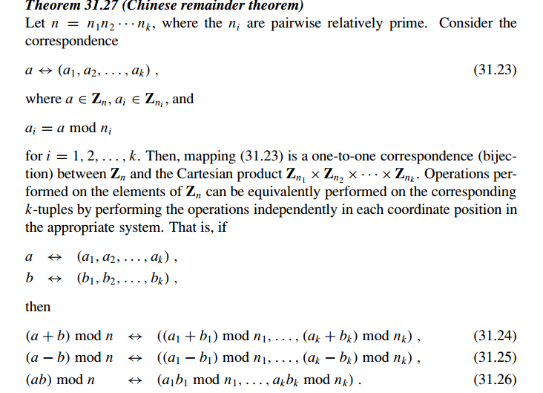

Slide 9
Thank You !!!

